Slide 1
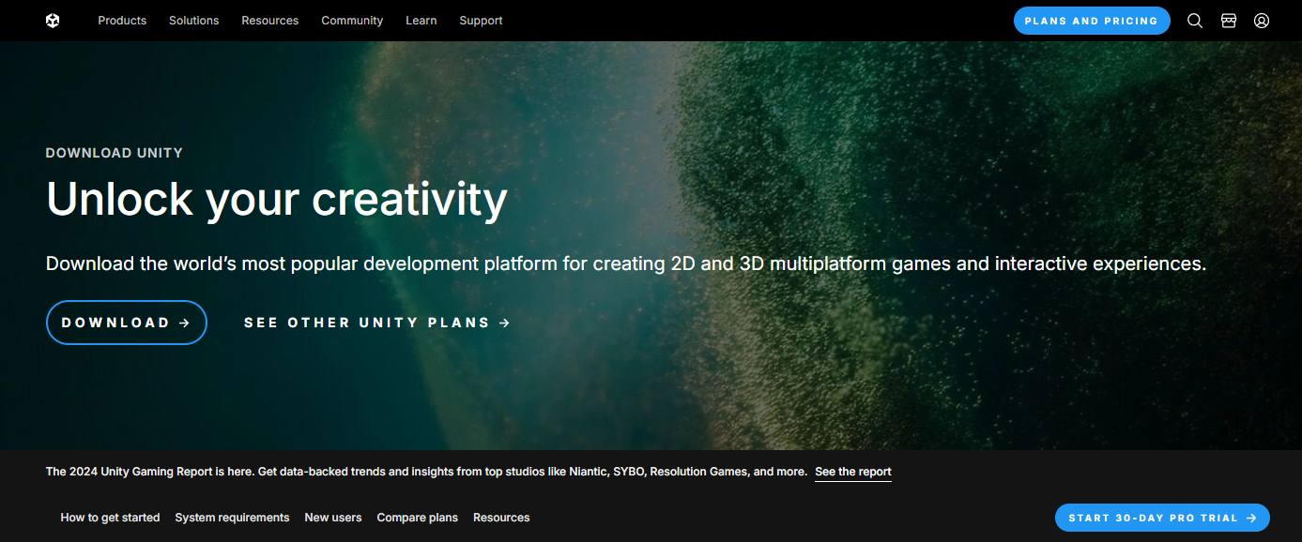
Install unity Hub https://unity.com/download
After installing Unity Hub install unity version 2022.3.27f1
Download Archive (unity.com)

Slide 2
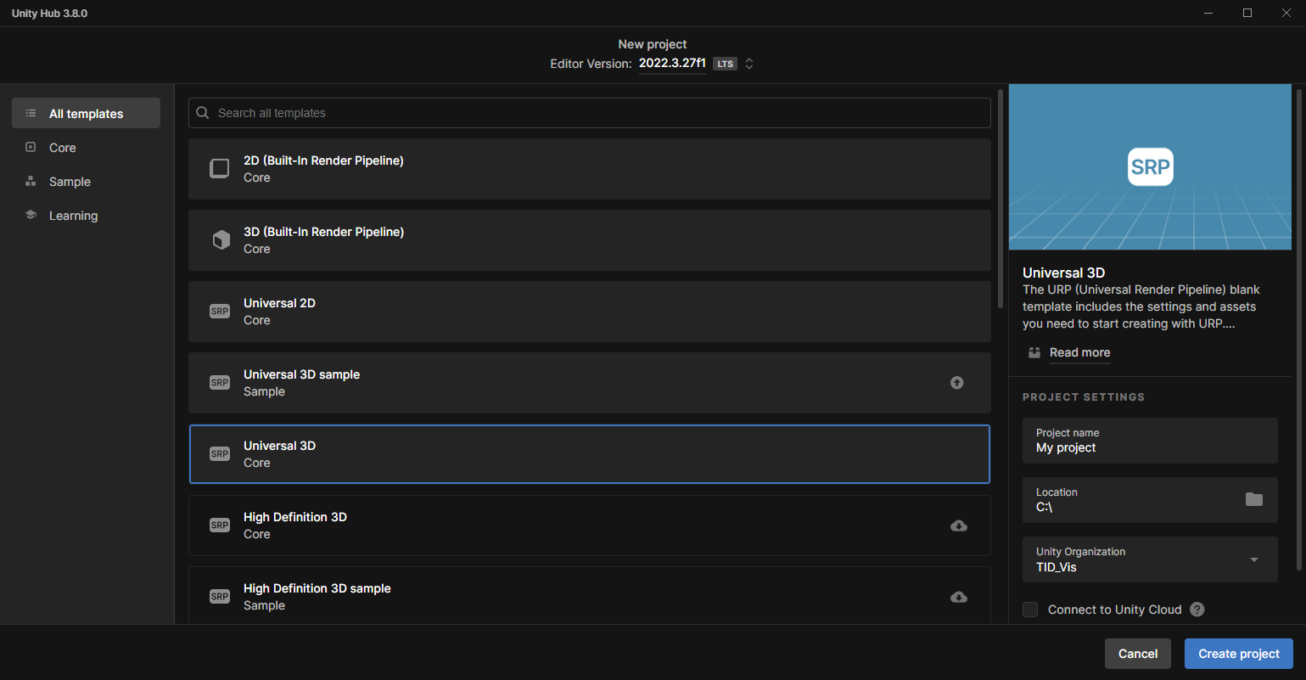
To create a new project using the Universal Render Pipeline (URP) core version, follow these steps:
1. Open Unity Hub.
2. Click on the "New Project" button.
3. Select the "Universal Render Pipeline" template.
4. Ensure that the editor version at the top reads 2022.3.27f1. This is the version used to create the project.
5. Name your project and choose a location to save it.
6. Click "Create" to set up your new project.

Slide 3
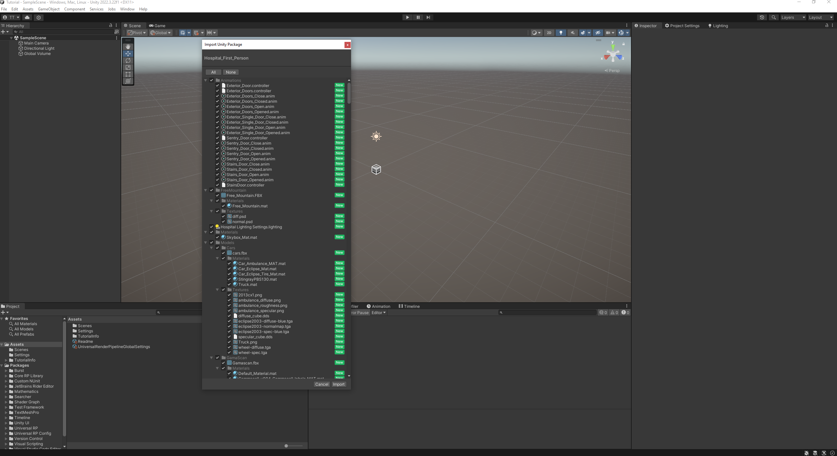
To Import the Hospital_First_Person.unitypackage into Unity, simply drag it into the Assets folder. The loading process may take a minute. Once completed, an import screen will appear; click "Import" to integrate the package into your project.

Slide 4
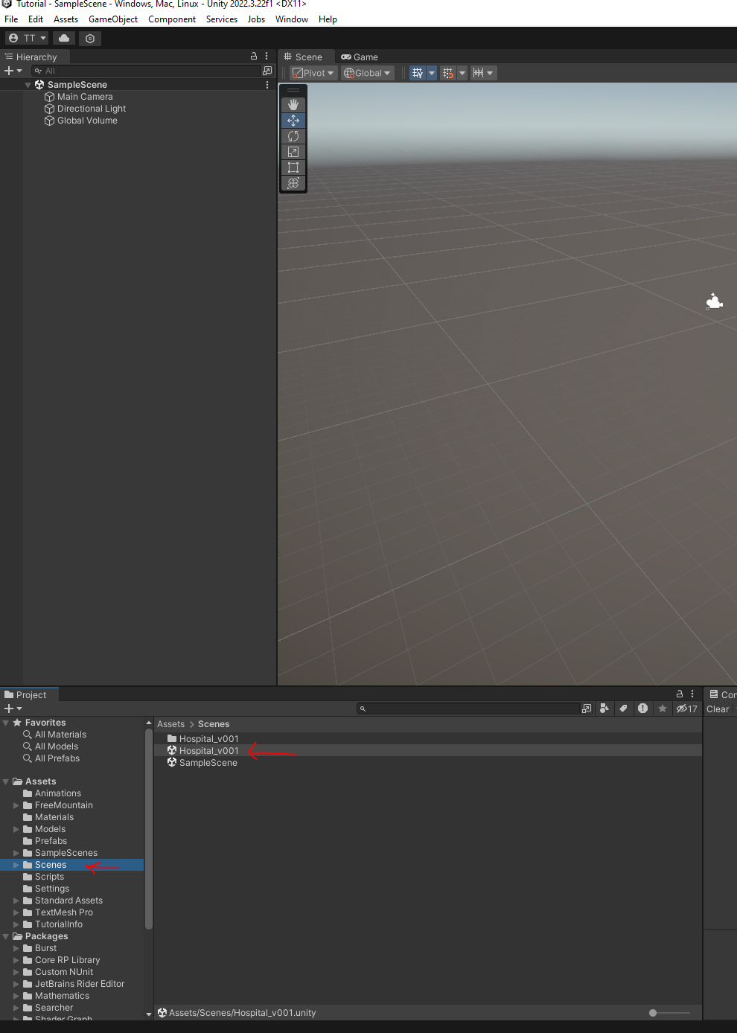
Next find the Scenes folder and Open the Hospital_v001 scene.

Slide 5
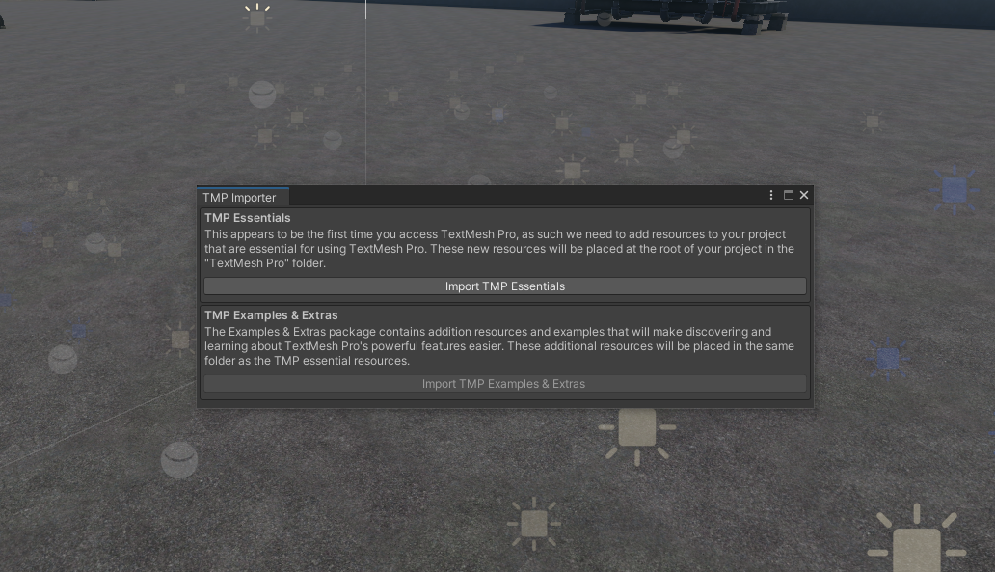
When you open the scene, you will be asked to import TMP. Press the import button and once it finishes close this window.

Slide 6
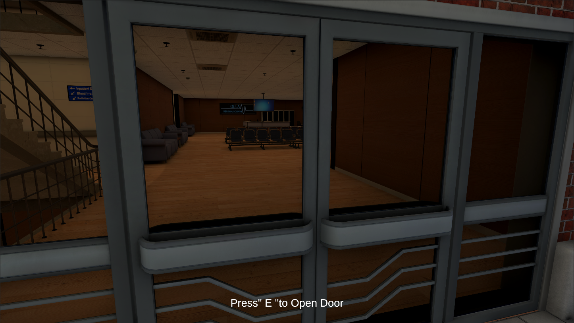
To navigate in the app use the WASD or arrow keys to walk around and the mouse to look around. To interact with objects use the “E” key.
W – Forward
A – Left
S – Backward
D - Right

Slide 7
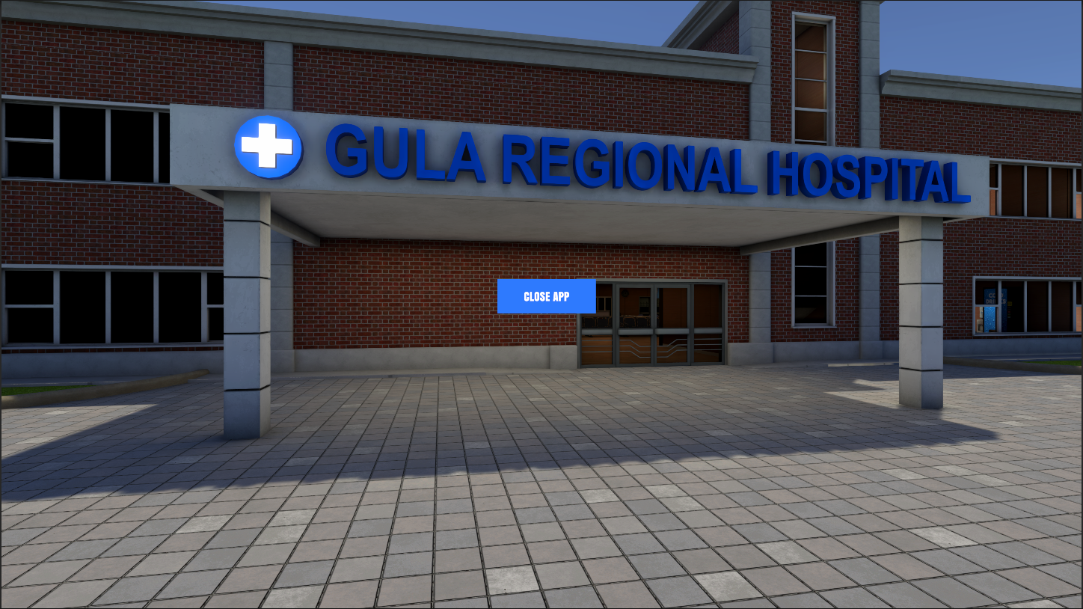
To quit the app hit the ESC key and the close app button will turn on.

